Slide 1
First Year Seminar; Week 1
Kalvis Apsītis

Slide 2
Different Ways to be Excellent
Why (#0): The importance of your topic, vision, motivation, "mission statement"
How (#1) Technical execution: Skills to perform work and use proper tools.
How (#2) Communication: Inside your team and with stakeholders.
How (#3) Subject matter: Knowing your topic, area of specialization.
What steps do you take to combine these?
How?
Why?
How?
How?
What?
Notes:
Can review Simon Sinek videos; etc.

Slide 3
Try to Address all these Questions
"'Why?' questions" – Selecting your problem topic and falling in love with it.
"Technical 'how?' questions" – Some workshops?
"Communication 'how?' questions" – Team working agreement; interacting with "stakeholders" and the "product owner" (Agile)
"Subject matter 'how?' questions" – Functional Design (researching your requirements); your experience and contacts.
"'What?' questions" – Doing Iterations; Minimum Viable Product
Notes:
Workshops should fit your needs, not the instructors' tastes.

Slide 4
Evaluation for this Course
How?
Why?
How?
How?
What?
Grading Rubric | What is | Typical Activities
Class Contribution | (Mostly Claudio) | Attendance; self-evaluations; some individualized contributions/grades.
Prototype Grading | (Mostly Kalvis) | Teamwork (team working agreement; issue mgmt; Agile studies etc.); Functional design (requirements); Configuration mgmt; Iteration planning; Validation/Real-World Data/Reporting.
Team Progress Reports | (Mostly Aldis) | Relevant business goals; interaction with stakeholders; risk management; adaptability to changes...
Final Presentation | All 3 instructors | Minimum Viable Product, Transfer of Information, Happy Customers, Nice Presentation

Slide 5
Prototype Grading (max 300 points)
Teamwork (max 50 points): Team Working Agreement Delegation (everybody knows what s/he should be doing) Task/Issue Management | Functional Design (max 50 points): Requirements are alligned with BizDev. Functional Design document Peer-reviews and reacting to these reviews. | Config. Mgmt. (max 100 points): Orderly procedure to apply changes. "Deliver Early and Often" Testability of your solution. | Iteration Planning (max 100 points): Planning, reviewing and retrospecting your iterations by Agile/Scrum methodology. Iteration 1 Iteration 2 Iteration 3 | Validation/Data (max 100 points): Perceiving real-world feedback. Metrics and Reports External data integration (mandatory for BITL teams)

Slide 6
Prototype Activities #1: Teamwork
Team Working Agreement (one-time activity)
Q1: Where is the “backlog”?
Q2: How to learn, who is doing what?
Q3: Where you can learn about the statuses from other people?
Q4: Where you will keep project files and deliverables?
Q5: How do interact; any internal meetings; resolving differences?
Issue Tracking and Project Management (continous)
Issue Tracking Tool/Approach (your method to track TODOs) – knowing what's important
Project Management (your method to track dependencies and important deadlines) – knowing what's urgent

Slide 7
Prototype Activities #2: Functional Design
Functional design answers the question: What the product or solution should do?
Large projects may have a separate list of requirements (traceable to the customer communication) and the Functional Design. You can combine, if you want.
Functional designs and requirements are easy to review (by instructors and other teams)
Eventually you should create a coherent story about your functionality – with screenshots and even technical hints (how to implement it).
Technical design is optional.

Slide 8
Prototype Activities #3: Configuration Management
Definition: A configuration is a set of artefacts (hardware, software items, files, settings) that enable your solution.
Even a static website or a social-media ad campaign has a configuration.
Configurations will be reviewed; they should be:
Easy to change (but still stable).
Easy to replicate
Ensure early prototypes and "proof of concept"
Testable

Slide 9

Prototype Activities #4: Iteration Planning
Every team reads and makes a presentation on a portion from the "Agile Book" (Essential Scrum by K.S.Rubin).
3 Iterations (2 weeks per iteration)
Each iteration is planned, done, reviewed, retrospected.

Slide 10
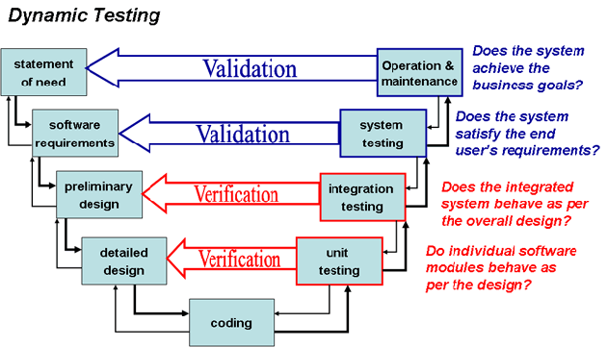
Prototype Activities #5: Validation
V-Model: Project starts and ends with goals and requirements.
A solution can learn from its own data.
BITL teams: Also need external data.
For other teams "big data" is desirable, but not mandatory.

Slide 11
Keep Things in Balance
Doing Actual Work
Doing "Pokazukha" or Window Dressing
"Happy project teams are all alike; every unhappy team is unhappy in its own way."
Staying Safe and Having Fun
Avoid various extremes:
Ignoring actual project work (in favor of trying to look good in the eyes of instructors, stakeholders, fellow students) OR
Striving for ambitious goals while neglecting reports on your progress OR
Forgetting about work-life balance OR
Being too friendly or too distant from your teammates OR ...
Notes:
We can

Slide 12
What is a Good Problem Topic?
There can be good and bad topics for a team project or a hackathon. Good ones lead to rich world of solutions; keeps team members (and stakeholders) engageed and interested.
Similar considerations apply as you pick subject for your bachelor/master/PhD thesis, or a subject for a news article (for a journalist), or a political issue (before elections), etc.
Start with the end in mind: The solution may change, but your goal typically does not.
Adjusting your goal is OK: It is called a pivot.

Slide 13

Problem Topic #1: Municipal Project Flow
Context: Visibility and involvement
Impressive project pipeline impressive, but most of it invisible.
https://www.valsts196.lv/
Merging with Vecumnieki and Iecava by mid-2021.
Many similar activities (repairs of municipal buildings and public infrastructure; municipal-advertized tenders).
Public discussions – when and where planned.
Much of actual planning still in MS Excel or other difficult-to-share formats.
Why is it a problem?
Low public interest means insufficient involvement; few people understand the issues; low voter turnout.
Public discussions may be formal; people do not know, where to go, who will listen, etc.
In most systems data becomes obsolete since the publishing date.
A parody of political advertizing. (Text in Latvian: "The Champions of good deeds and the person accused of serious good deeds.")
Notes:
Project viewer systems – short descriptions and relevant info. Individual project’s status page: Updates in development and changes in budget. Statistics and subitems.

Slide 14
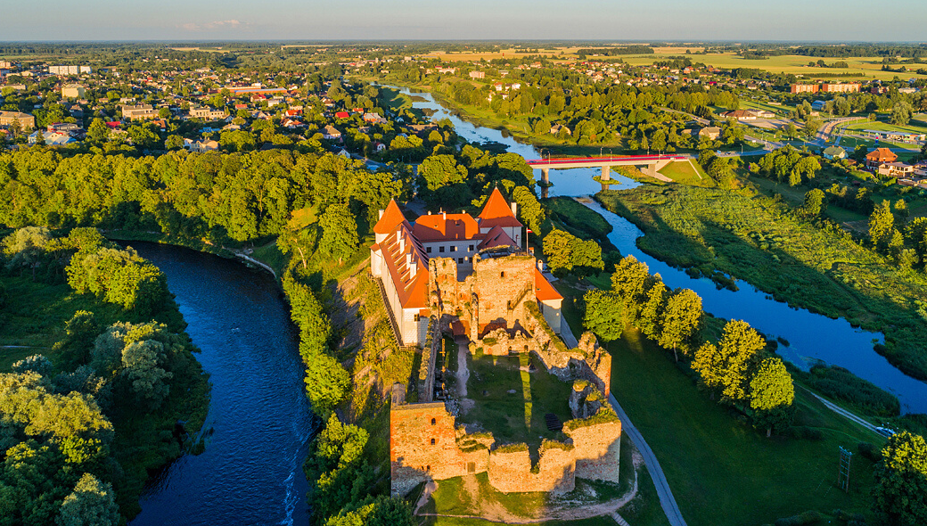
Problem Topic #2: Tourism in Bauska
Context: Bauska/region as a destination or as an intermediate stop.
Many visitors; lots of transit.
"Meistars Gothards" etc. NGOs and small enterpreneurs along with official tourism channels and tour operators.
Rija Bauska hotel and offers for Riga clients who do
Old Town interesting but underappreciated.
Why is it a problem?
Many visitors – actual and potential - do not stop in Bauska or do not know about the amenities (places to eat, relax, visit).

Slide 15
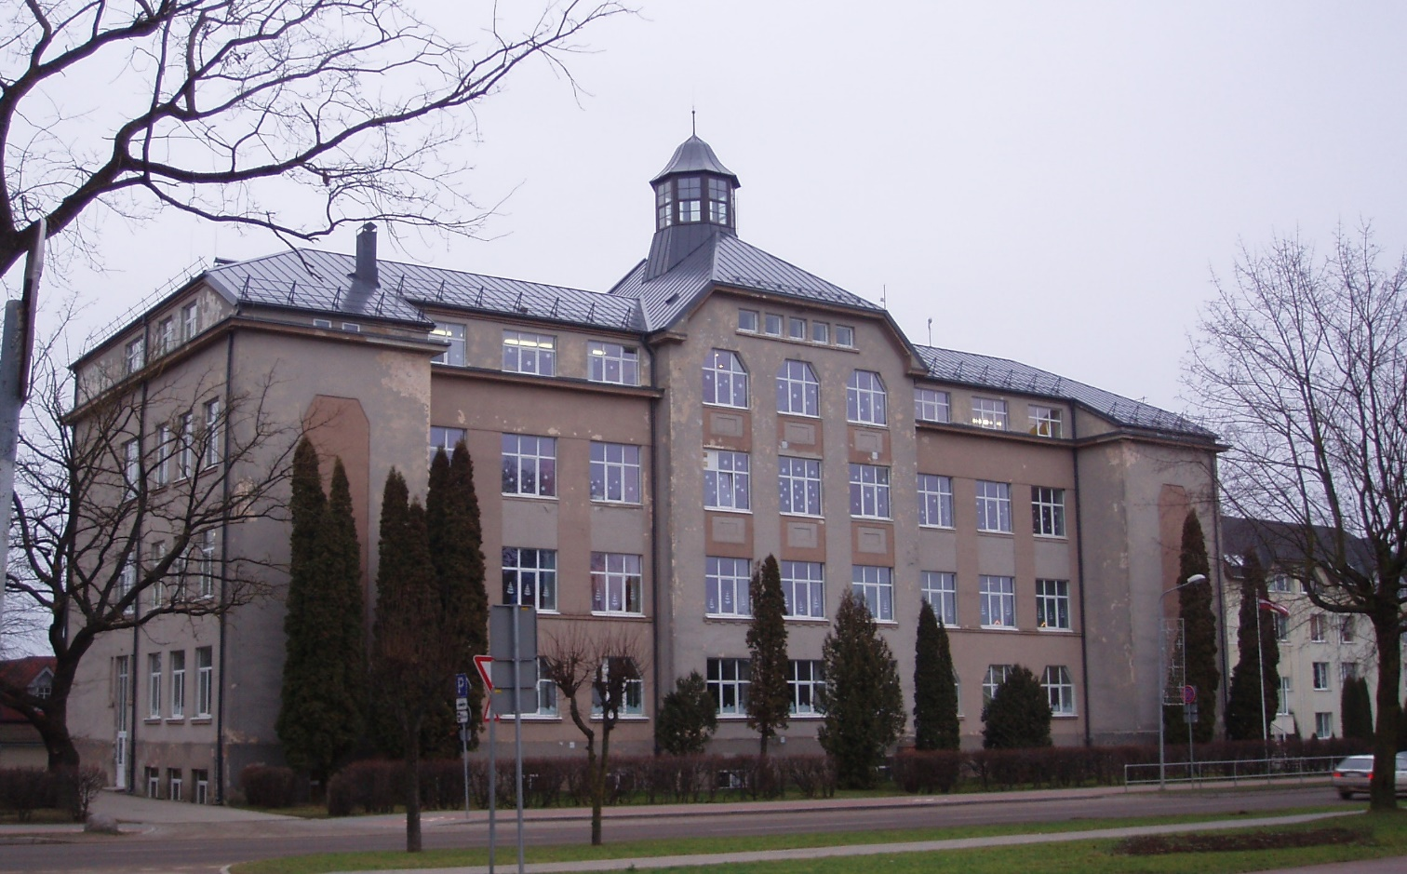
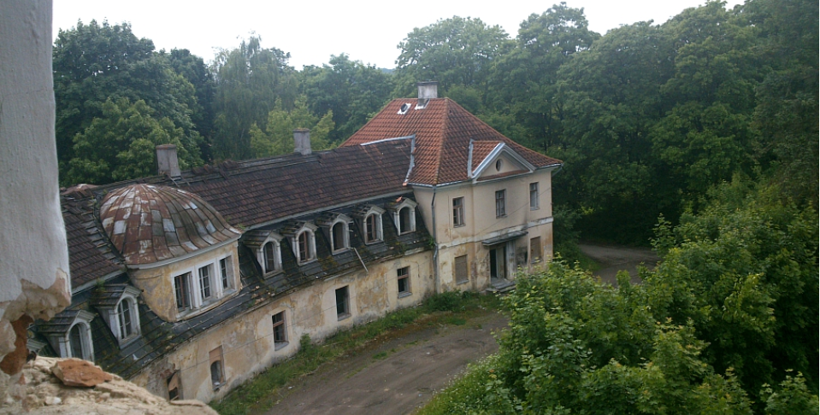
Problem Topic #3: Schools
Context: Schools in the region reorganized; further improvements are harder.
The network of schools pretty much concentrated already.
Easy to contact stakeholders (pupils, teachers, etc.), meaningful change not easy.
Professional education – Kaucminde/Saulaine (historically famous but with problems).
Bauska State gymnasium
Why is it a problem?
Bauska State Gymnasium has to offer different study tracks; accreditation by centralized exam results – harder to achieve than in Riga.
Career education, participation in exchange programs still insufficient.
Young people leaving region in droves – even after Grade 9.
The fate of the school may depend on the director and their overall vision (not even individual teachers).
Kaucminde Mannor

Slide 16
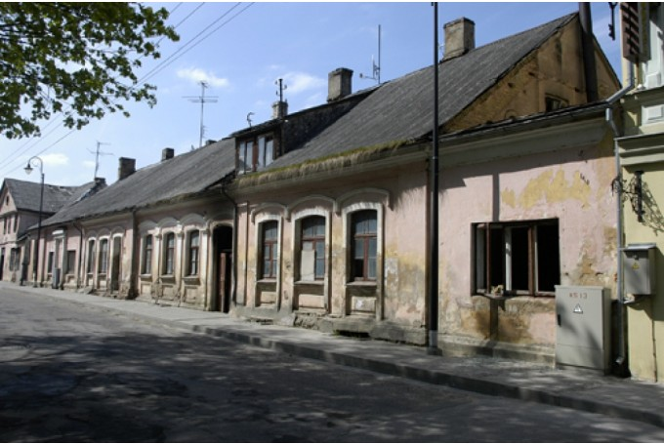
Problem Topic #4: Social Risks
Context: Location and lifestyles related with poverty.
Old Town is not just interesting to visit; it often correlates with poverty and substandard housing.
Social risks may be related to addictions, gambling.
Not enough resources or experience to get EU grant money for thermoisolation, renovation.
Bauska Old Town
Why a problem
Professional assistance can be very beneficial, but vulnerable people often "fall through the cracks".
Often political risks (as in zoning laws governing gambling)

Slide 17
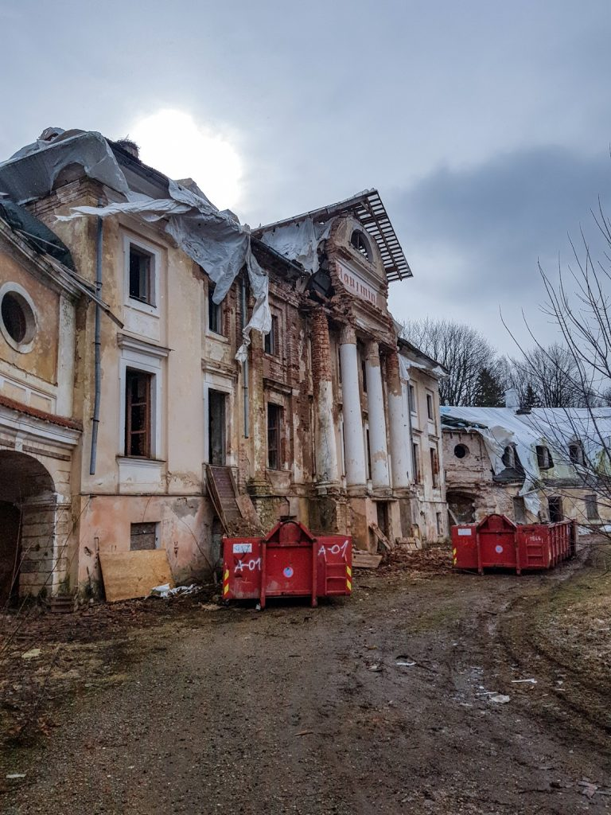
Problem Topic #5: Depopulation and Labor Geography
Context: Important & not urgent; change over years
Mežotne selection station, local enterprises disappearing
Uzvara village (Gailīši parish) – nice infrastructure, rapidly depopulating.
Some people still living, but less economic activity.
In Bauska no worries about land falling out of use.
Why a problem
Municipality has to align things – put the money where the mouth is.
Regions and priorities shift.
People might want to, but cannot always work remotely

Slide 18
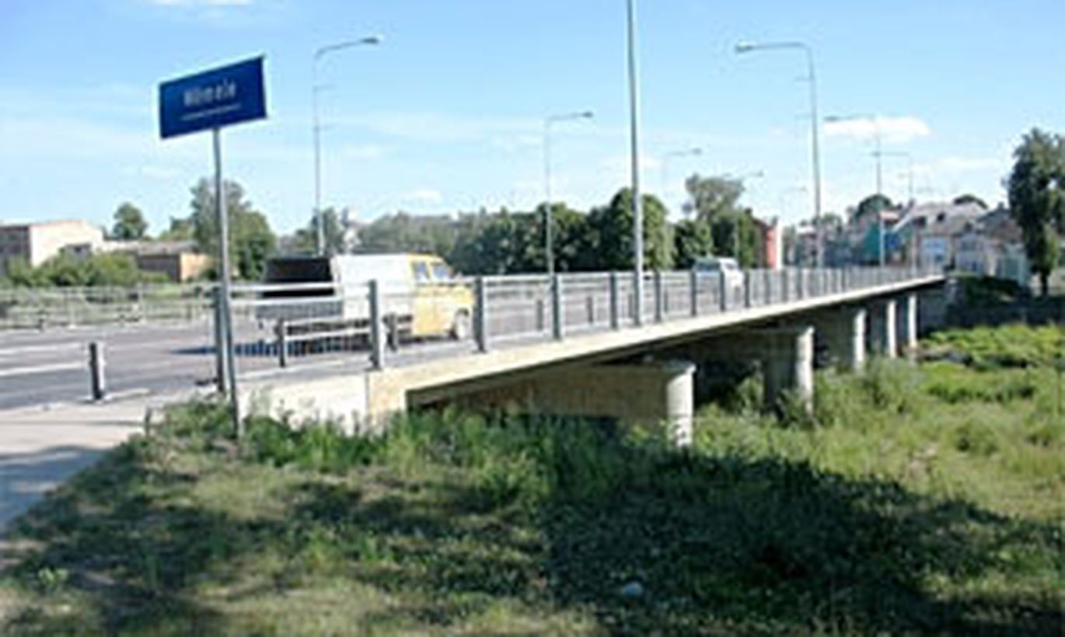
Problem Topic #6: Transportation
Context: Distinguish transit, local transport, public transport
Bauska has lots of transit – shortest path from Berlin to Helsinki; Mēmele bridge is a choke-point. (Jelgava – alternative path.) Some 17000 vehicles cross the city daily.
Police/video data.
Locals prefer using cars too; closing little streets for traffic – not popular.
Public transportation exists – limited appeal.
Rail Baltica and other projects/promises.
Why a problem
Conflicts with other goals (architecture preservation; nice tourism, etc.). Many tourists never get further than K-Circle.
Congestion and air quality.

Slide 19
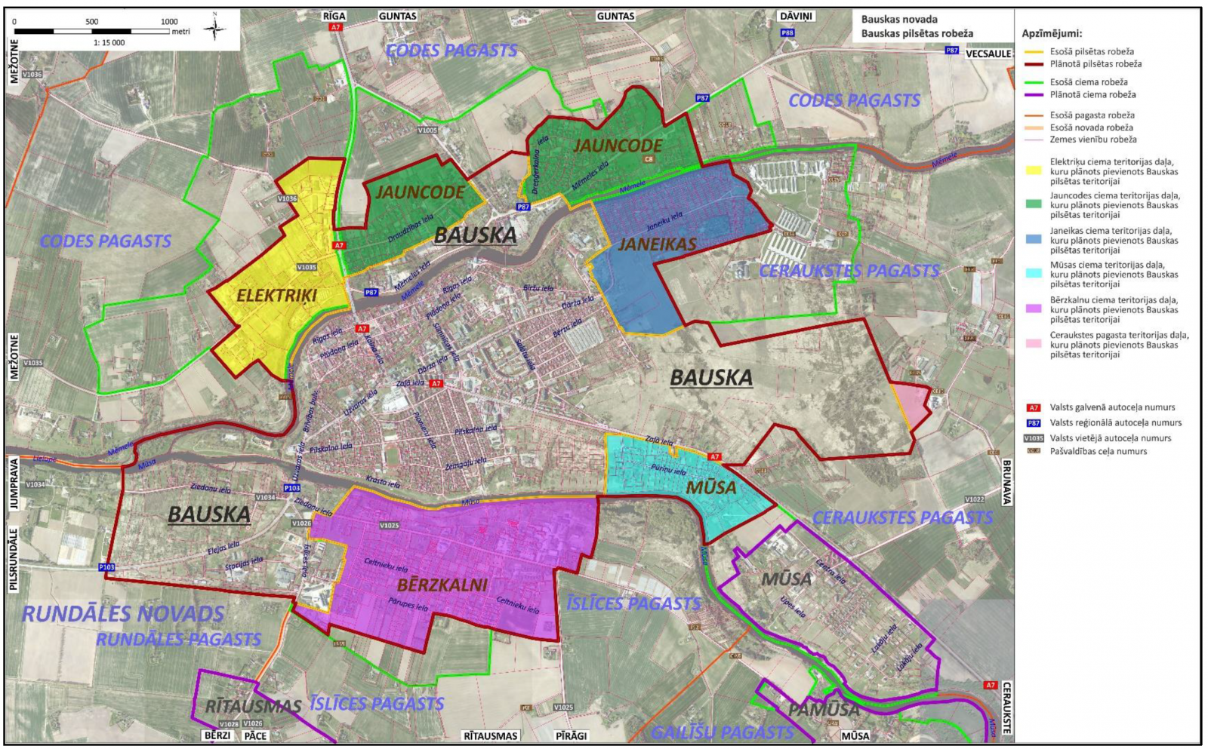
Problem Topic #7: Garbage Collection
Context: Some 2 operators; can ensure that they ensure sorting/containers. Can have some satellite data – but not well matched to ground-real.
Why problem: Poligon use for wrong purposes. Not the right kind of sorting. Oligopolies and conflicts of interest.
Notes:
https://www.bauska.lv/print.php?url=lv/lidzdaliba/publiska-apspriesana

Slide 20
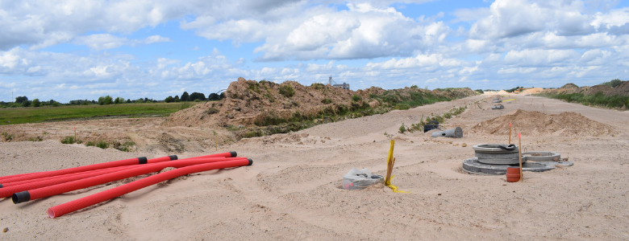
Topic #8: Industrial Cluster Near Bauska
Context
Govt, EU Programs; some investment; great opportunities for bioethanol.
Why a problem?
Some 700 jobs should appear by 2023 near Īslīce – or some return of received grant money.

